Slide 1
VFW Auxiliary Historian/Media Relations
Preserving Our Legacy:
The Role Of The VFW Auxiliary Historian
Presented by Kathy Ingall
Department of Florida
February 2026

Slide 2


Slide 3

What Is a Historian?
Memory Keeper: Collecting and documenting the “Who, What, Where, When, and Why” of events
Storyteller: Captures the heart of service through photos, memorabilia, and digital media
Media Advocate: Promote National Programs, share updates via newsletters, social media (including reels) news clips and the press
Archivist: Maintains scrapbooks, digital frames, and historical records to spread awareness of Auxiliary work

Slide 4
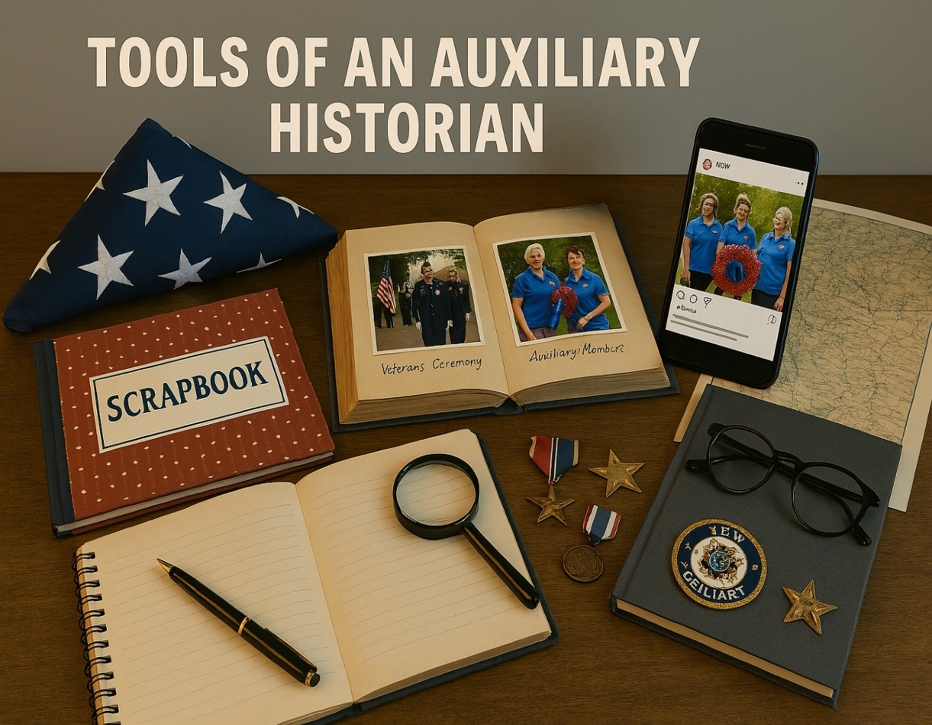
Who is a Historian ?
Everyone
Do you capture moments through photos, notes, cards, or event posters/banners?
By doing so, you are documenting a history of events. Have you considered sharing your findings with your Historian? Since they cannot be present at every occasion, you might have recorded something that could be valuable for all members to see or learn about.

Slide 5
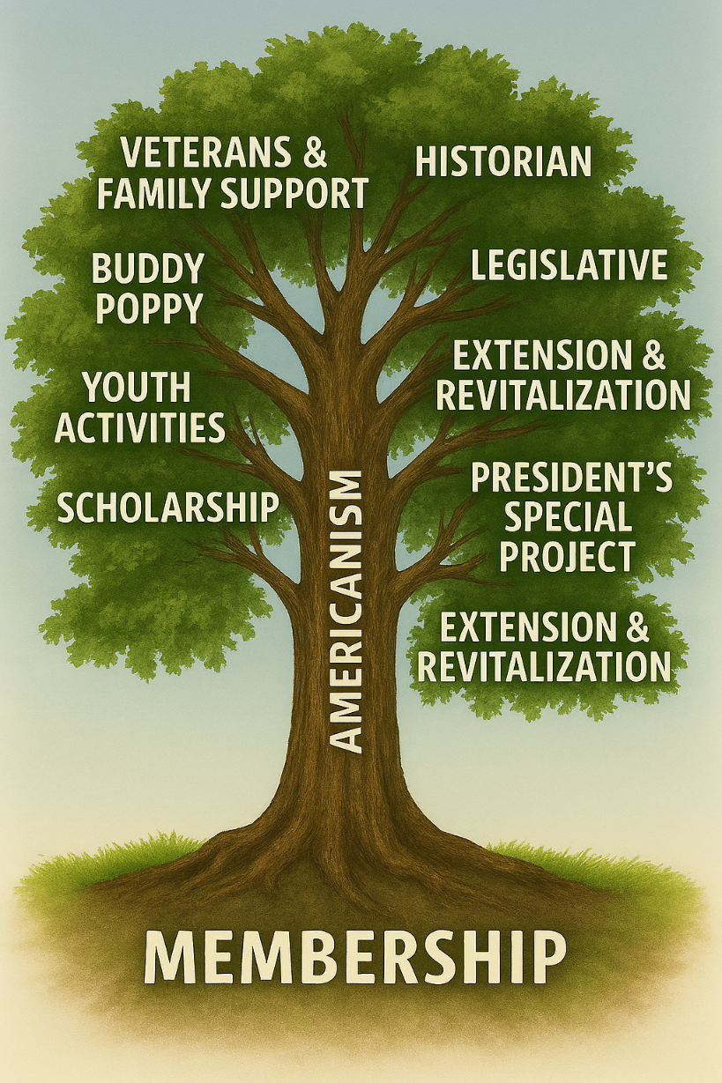
Collaborating for Impact
Work with Program Chairmen and Presidents
Coordinate event documentation
Inspire involvement
Submit year-end reports

Slide 6
Why It Matters
Honors veterans and their families
Preserves traditions for future generations
Promotes awareness of Auxiliary programs
Celebrates achievements and milestones
Encourage community involvement

Slide 7
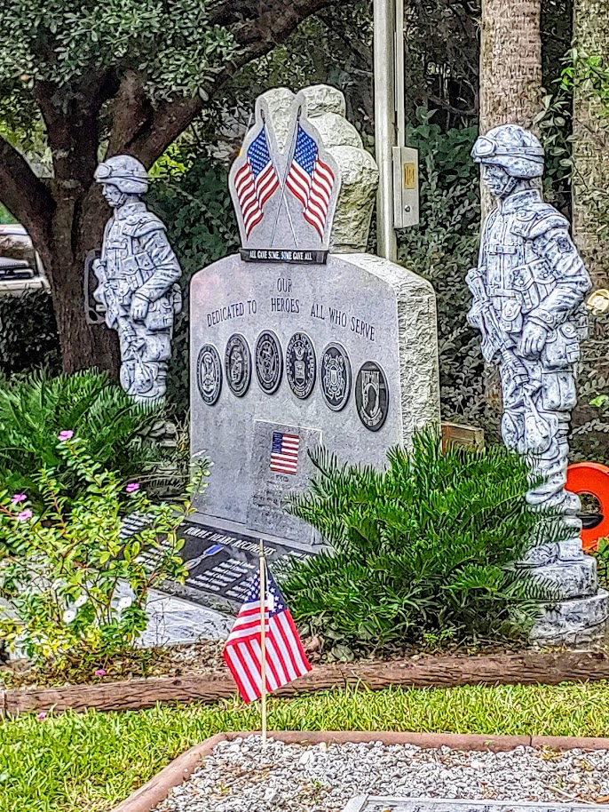
Creative Ideas
Spotlight Veterans stories
Themed scrapbook pages
Monthly photo highlights
Social media campaigns

Slide 8
Tools of the Historian
Tool | Purpose
Photographs | Capture moments of service and camaraderie
Written Reports | Document events and achievements
Scrapbooks | Preserve tactile and visual memories
Digital Frames | Showcase highlights in modern formats
Social Media | Share updates and promote awareness

Slide 9
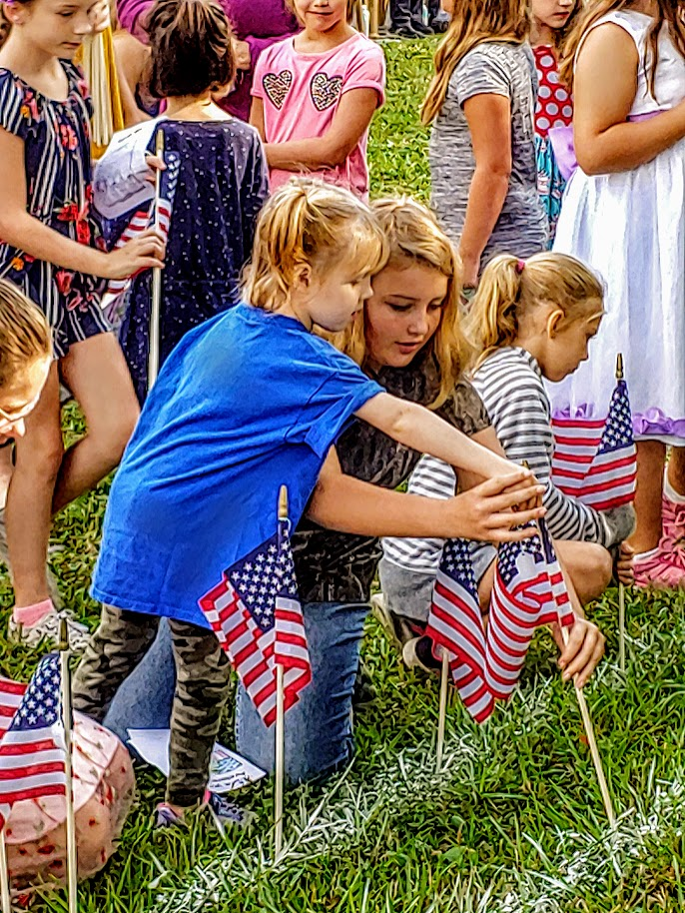
Celebrating America’s 250th Birthday
2026 marks America’s Semi quincentennial-250 years of freedom and resilience
Historian’s role: Capture commemorative events, parades, and patriotic outreach
Suggested theme: "Honoring Our Past, Inspiring Our Future“
Include special scrapbook pages, photo collages, and community stories
Compiles records from installation to installation, including event programs

Slide 10
Closing Message
"We are the bridge between memory and legacy." Encourage members to contribute photos, stories, and memorabilia to preserve our shared journey.

Slide 11


Slide 12
